Slide 1
Optimizing RIDE Sharing allocation
Analysis on Ridership Allocation for Transportation Network Providers (Uber/Lyft/Via, etc.)
Presented by:
Duo zhou, Amily huang, bowen zhao, Yiheng Zhu

Slide 2
Executive Summary
Our goal is to optimize vehicle allocation according to ridership demand and give business insights and recommendations to TNP companies (also called rider sharing companies like Uber, Lyft and Via).
We use data regarding weather, major sport events, public safety, and census to analyze customer behavior and to give precise recommendations.
We create a relational database system that can efficiently load, store, and extract data from different sources for analysis.
Notes:
which is essential to the success of Transportation Network Providers (TNP) (Rideshare Companies)
Ridership demand can be greatly affected by, and many other factors.

Slide 3
Business Use Case
Actor | Incentive | Business Use
TNP | To better understand customer behavior Vehicle allocation Optimization Improve customer service management | Understand how different factors impact ridership and customer behavior
Driver | Maximize income per unit time | Understand how tips vary in different circumstances
Customer | Time-efficient and safer service | Improvement of service experience with better vehicle allocation and customer service
Notes:
TNP can utilize our analysis to optimize their vehicle allocation system according to various factors.
TNP can use our analysis to better understand customer behavior based on various factors.
Drivers can use our analysis to find locations where ridership demand is high and customers tip very generously.
TNP can further increase the maximum wait time for locations that have high crime rate. Which can greatly benefit customers

Slide 4





Solution overview: Data / Tools
Main dataset:
Data Processing:
Visualizations:
Transportation Network Providers – Trips by Location, Distance, Day/Time, Tips, etc.
https://data.cityofchicago.org/Transportation/Transportation-Network-Providers-Trips/m6dm-c72p
Tablaue
Python:
Matplotlib
Seaborn
ggplot
Plotly
Python
- Data Cleaning and Processing
Excel
- Data Cleaning and Processing
UChicago RCC
- Cloud Computing for Large Datasets
Data Connectors:
Supporting dataset:
Weather
– Historical Weather Conditions, Short-term Forecasts
https://www.ncdc.noaa.gov/cdo-web/datasets
CSV Extracts
Python
- WebScraping
NoAA
- API
Geography
– Community area boundaries in Chicago
https://data.cityofchicago.org/Facilities-Geographic-Boundaries/Boundaries-Community-Areas-current-/cauq-8yn6
Analytics:
Sports Event
– Chicago sports team (NBA,NFL,MLB) schedules
https://www.espn.com
Python:
Data Analysis
Census & Crime
https://datahub.cmap.illinois.gov/dataset/community-data-snapshots-raw-data
https://data.cityofchicago.org/Public-Safety/Crimes-2001-to-present/ijzp-q8t2

Slide 5
DATA PREPARATION
Data Source | Format and Size | Processed Data That Meet Analytical Needs | Platform and Tools Used
Chicago Data Portal: Transportation Network Providers | 50 GB (129 Million Rows, 21 Columns) Structured CSV File | Ridership, Avg Traveled Distance, Avg Tips and Number of Pooled trips Group by CCA, Date and Time | Python, mySQL GCP and RCC
Chicago Data Portal: Boundaries - Chicago Community Areas (CCA) | 1.92 MB Structured CSV File | MULTIPOLYGON Data by CCA For Tableau | Python and Excel
Chicago Data Portal: Crimes | 12 GB (7.12 Million Rows, 22 Columns) Structured CSV File | Total Number of Crimes By CCA | Python, mySQL GCP and RCC
ESPN | 2 MB Unstructured Data: From Web Scraping | Only the Home game dates and location | Python and Excel
National Centers for Environmental Information | 5.5 MB Structured CSV File | Avg daily temp, total daily precipitation and avg daily wind speed by date. | Python and Excel
Wikipedia: Community Areas in Chicago | 0.1 MB Unstructured Data: From Web Scraping | Chicago community area code | Python and Excel

Slide 6
DATA MODELING
Compiling Data into Tables
We used MySQLWorkbench to create our dimensional table. Sports and weather tables are indexed by Date (primary key), Census and Crime tables are indexed by Chicago Community Areas(CCA) (primary key). Date and CCA are both linked to the fact table as foreign key.
Data Transformations
All data are transformed into a rows and columns format with appropriate data type.
Data Mapping
We have one main dataset (fact table with ridership measures) and four supporting datasets (dim tables). A star type dimensional model is adapted by linking 4 dimensional datasets to the main fact dataset using either DATE or CCA. Note: Ridership By Hours of A day is an independent analytical entity that provides additional business insights on ridership.
Main dataset ridership measures are aggregated and grouped by CCA, date and time.
Sports schedule datasets, and weather datasets are aggregated and grouped by date.
Census and Crime datasets are aggregated and grouped by CCA.
CCA Geographic boundaries data are transformed to meet tableau virtualization requirement

Slide 7
DESIGN CONSIDERATIONS
Data Types
id: INT
Date: DATE
CCA: INT
MEAN & MEDIAN attributes: DOUBLE
Others: INT
Dealing with NAs
Weather: Drop NA rows
Main Dataset: Fill NA with 0
Using Dimensional Tables
- Maintain historical information for any dimension
- Less processing time and higher performance
Expected Output of Data Analysis (Data Quality Metrics)
- The relationship between income level and ridership
- The impact of ridership on different weather
- The impact of ridership during major sports event
- The relationship between public safety and ridership

Slide 8
Completeness: Missing Values in Weather Dataset treated as zero
Validity: Data is transformed into fact and dimensions to meet our analytical need
Uniqueness: No duplicate data
Consistency: Data format is consistent throughout the database
Timeliness: The data represent reality in time as data consist all the entries over the period considered
Accuracy: Data is simply aggregated by summing and averaging over locations and dates, and this transformation can accurately represent reality
Data Quality Dimension

Slide 9
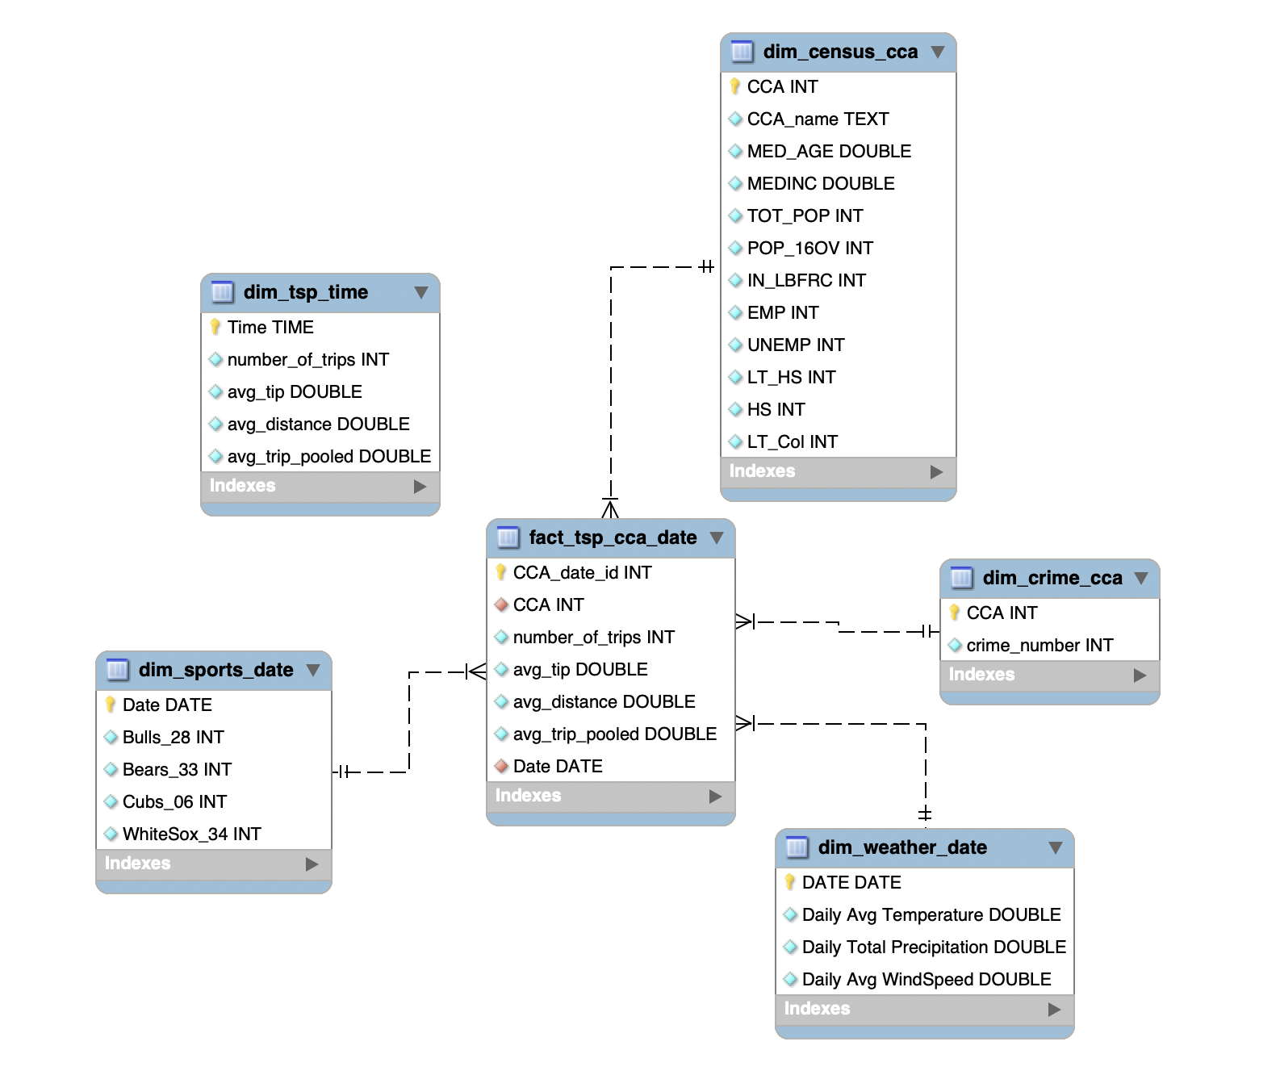
Enhanced Entity Relationship diagram
Notes: dim_tsp_time table is an independent table to analyze the ridership within a day.

